Slide 1

Distribution padding
Duc Nguyen, Seonghwa Choi, Woojae Kim, Sewoong Ahn, Jinwoo Kim, Sanghoon Lee
Yonsei University

Slide 2
What have we done to improve neural net’s performance?
Architectures
  AlexNet, VGG, ResNet variants, DenseNet variants, GoogLeNet variants,
Initialization schemes
  Constant initializations, Xavier, He, truncated Normal, weight normalization, Fixup, …
Optimizers
  SGD, Adam, Adadelta, RMSProp, AdaBound, batch normalization, …
Activations
  ReLU, Sigmoid, Tanh, SELU, eLU, pReLU, lReLU, Swish, …
Padding
  Zero, reflection, replication, partial convolution, ???
Little work dedicated to improve convolution itself

Slide 3
Why padding matters?
“In addition to the aforementioned benefit of keeping the spatial sizes constant after CONV, doing this actually improves performance. If the CONV layers were to not zero-pad the inputs and only perform valid convolutions, then the size of the volumes would reduce by a small amount after each CONV, and the information at the borders would be “washed away” too quickly.” - http://cs231n.github.io/convolutional-networks/

Slide 4
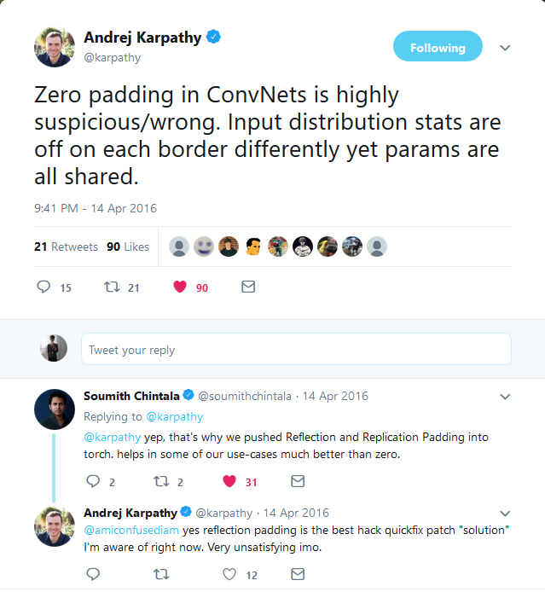
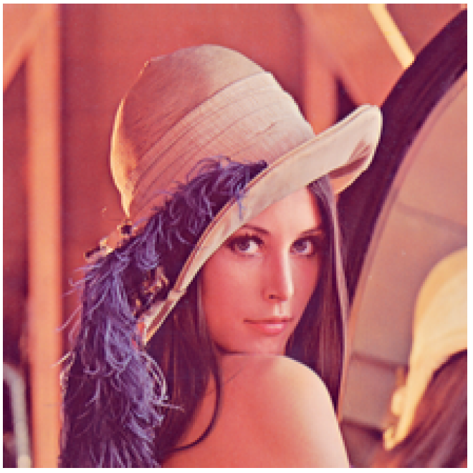
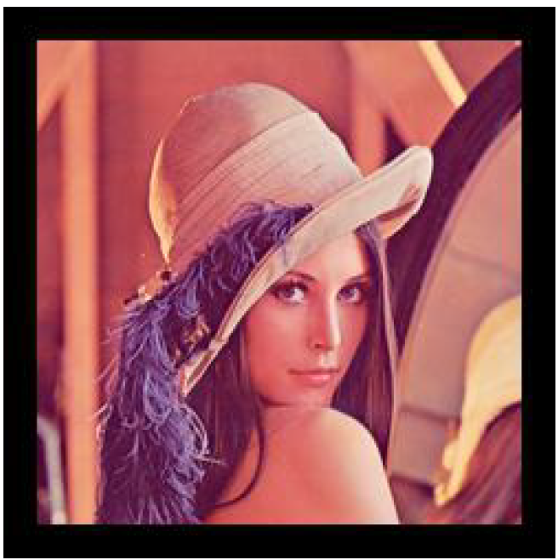
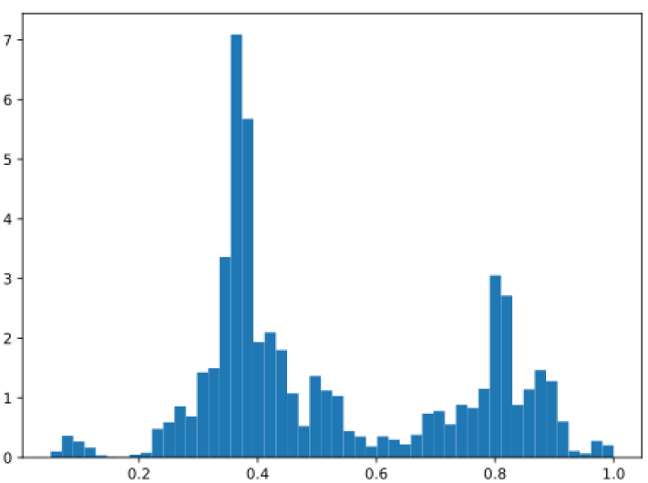
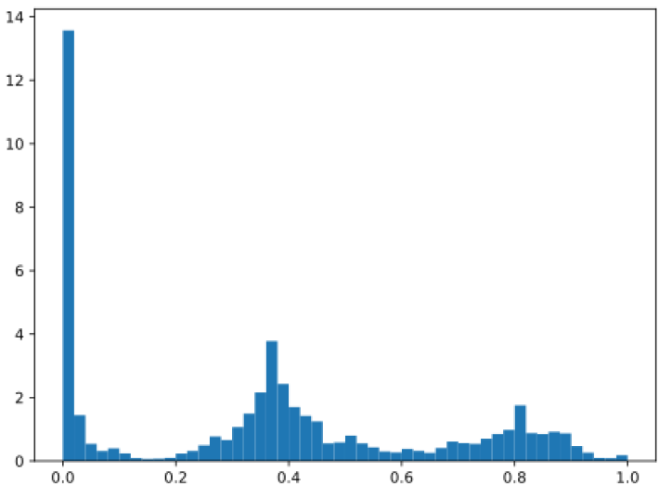
Zero padding is wrong
CNNs “cheat” by learning statistics at pixel level
  If the distribution of images is altered, CNNs learn something unexpected
Lena image
Lena image with zero padding
https://twitter.com/karpathy/status/720622989289644033?lang=en

Slide 5
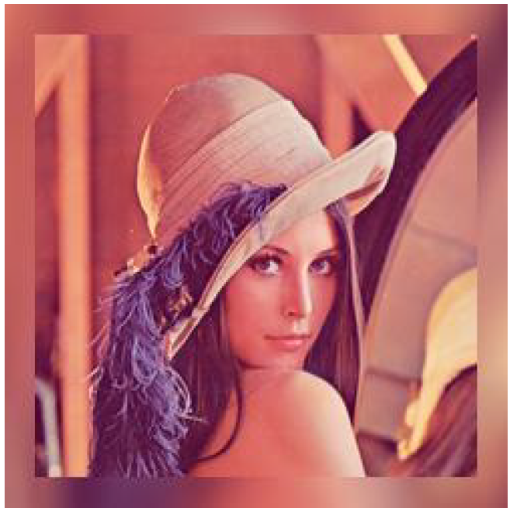
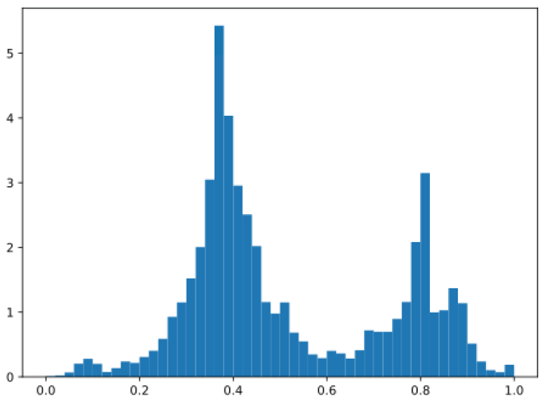
Zero padding is wrong
Why?
  The input distribution at the borders is highly different from that of the original image
  The pre-activation magnitudes at the border are much smaller than other regions
  The filters are shared, which means they are required to be used to the weird statistics at the borders as well as other regions
In practice, image generation related tasks are most affected by zero-padding
Expectation

Slide 6
Related work
Most famous padding scheme: zero-padding
  Pad zeros to the border of an image, deterministic dropout
  Works well in image classification
Most famous alternative: reflection padding
  Reuse the border values to pad the image, still distorts the border distribution
  Works well in image generation tasks
Most recently proposed method: partial-convolution padding*
  Does not actually pad anything
  Performs convolution as if the image is padded with zeros, and then rescale the output border according to the window size
  Works well in image inpainting
*”Partial Convolution based Padding” – Liu et al. 2018

Slide 7
Distribution padding
2 variants
Mean interpolation padding
  The padded parts are the interpolations of the means of the border regions
Mean reflection padding
  The padded parts are the reflections of the means of the border regions
  Inspired by reflection padding
Maintain roughly the means near the border regions
However, the variance is underestimated
  We can preserve the variance too but this would complicate the method (padding should be simple)
  Can’t naively pad the means

Slide 8
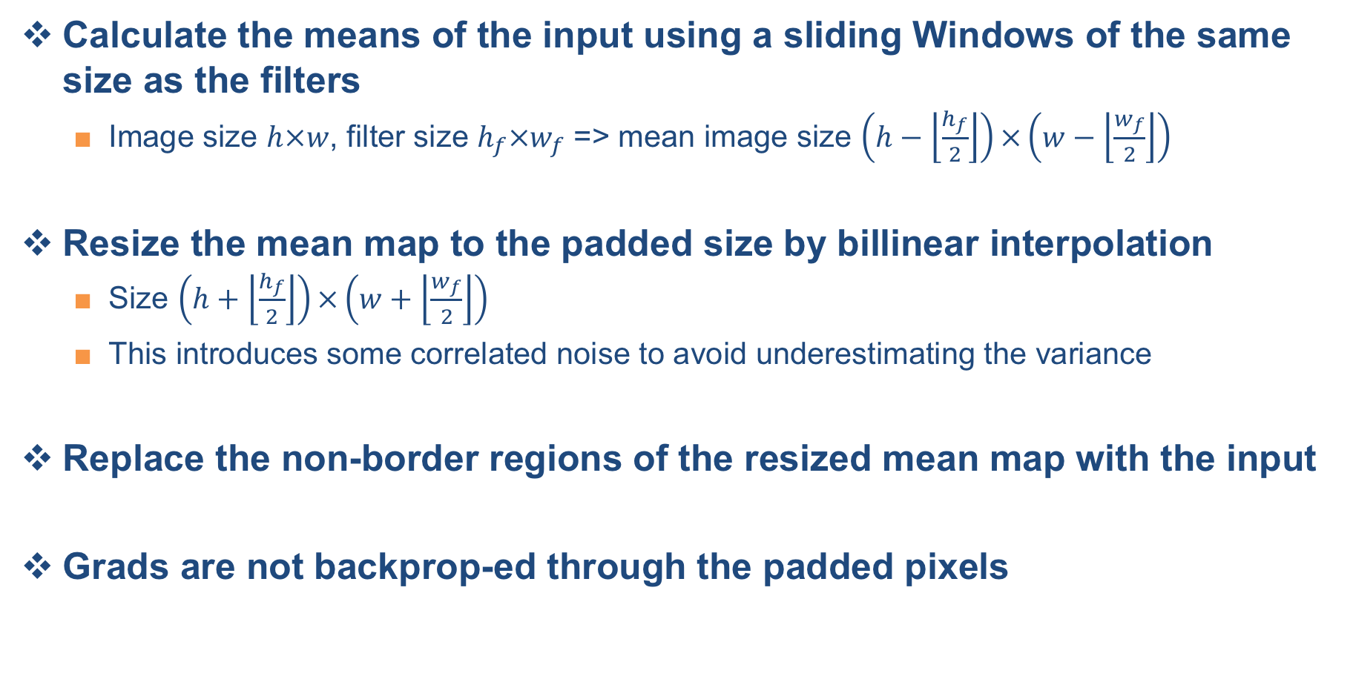
Mean interpolation padding
Calculate the means of the input using a sliding Windows of the same size as the filters
  Image size $h×w$, filter size $h_{f}×w_{f}$ => mean image size $\left(h−\left\lfloor \frac{h_{f}}{2}\right\rfloor \right)×\left(w−\left\lfloor \frac{w_{f}}{2}\right\rfloor \right)$
Resize the mean map to the padded size by billinear interpolation
  Size $\left(h+\left\lfloor \frac{h_{f}}{2}\right\rfloor \right)×\left(w+\left\lfloor \frac{w_{f}}{2}\right\rfloor \right)$
  This introduces some correlated noise to avoid underestimating the variance
Replace the non-border regions of the resized mean map with the input
Grads are not backprop-ed through the padded pixels

Slide 9
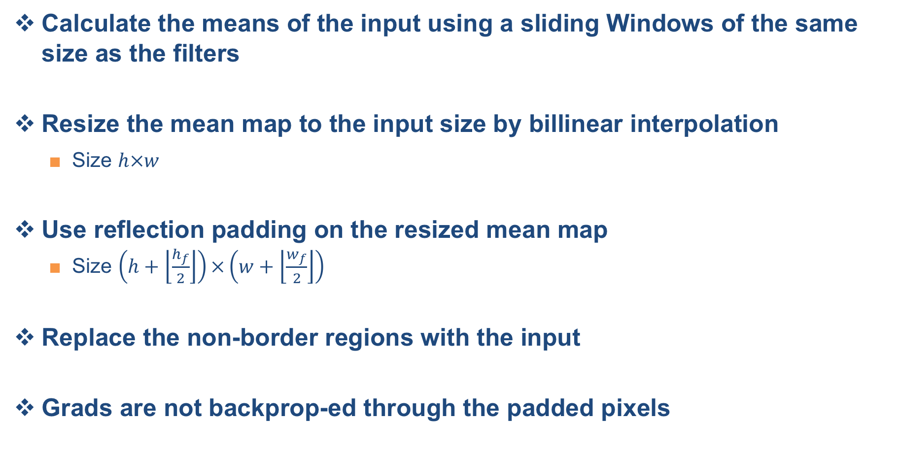
Mean reflection padding
Calculate the means of the input using a sliding Windows of the same size as the filters
Resize the mean map to the input size by billinear interpolation
  Size $h×w$
Use reflection padding on the resized mean map
  Size $\left(h+\left\lfloor \frac{h_{f}}{2}\right\rfloor \right)×\left(w+\left\lfloor \frac{w_{f}}{2}\right\rfloor \right)$
Replace the non-border regions with the input
Grads are not backprop-ed through the padded pixels

Slide 10
Experiments: classification
Train two architectures: ResNet34 and VGG19
  CIFAR10
  Adam 1e-4
  l2 regularization 5e-4
  100 epochs
  Validate the model every 1000 iterations
  Train each 5 times
  Benchmarking: zero padding, reflection padding, and partial convolution
Except for padding, all the setups are the same
Code to reproduce the paper (Theano)
  https://github.com/justanhduc/distribution-padding

Slide 11
Experiments: classification
Classification errors on the test set

Slide 12
Experiments: classification
Classification errors on the test set (magnified)

Slide 13
Experiments: classification
Mean error over the last 5 validation times
  VGG benefits more from the proposed padding
  This can be explained by the fact that the residual connection adds the original signal to the output of a res block, which helps reduce the bad effect of zero padding
  Mean interpolation is better than mean reflection
    Mean reflection duplicates values => doesn’t preserve the statistics well
Padding type (Resnet) | Error (%)
Zero | 12.09
Reflection | 11.78
Partial | 11.80
Mean interpolation | 11.74
Mean reflection | 12.33
Padding type (VGG) | Error (%)
Zero | 10.97
Reflection | 10.80
Partial | 10.77
Mean interpolation | 10.54
Mean reflection | 10.67

Slide 14
Experiments: style transfer
Setup
  Architecture: WCT network*
  Training data: MS COCO
  Test data: random images on Internet
  Training duration is 3 epochs
  padding schemes: zero padding vs reflection padding
We failed to train the largest decoder using partial convolution padding
  It may suggest the method is not versatile
* “Universal Style Transfer via Feature Transforms” - Li et al. 2017.

Slide 15

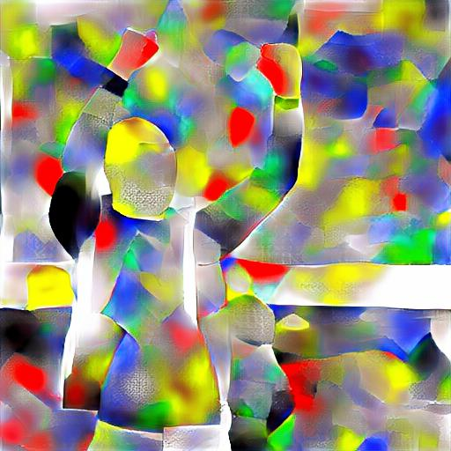
Experiments: style transfer
Mean reflection padding
Zero padding

Slide 16
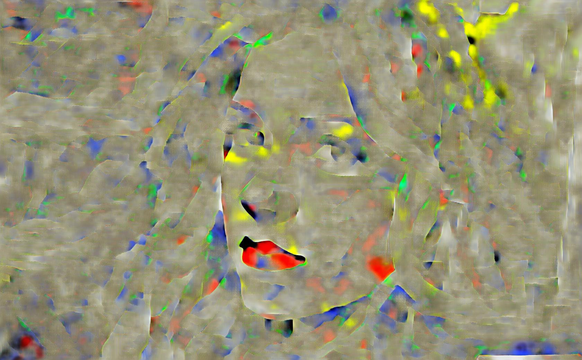
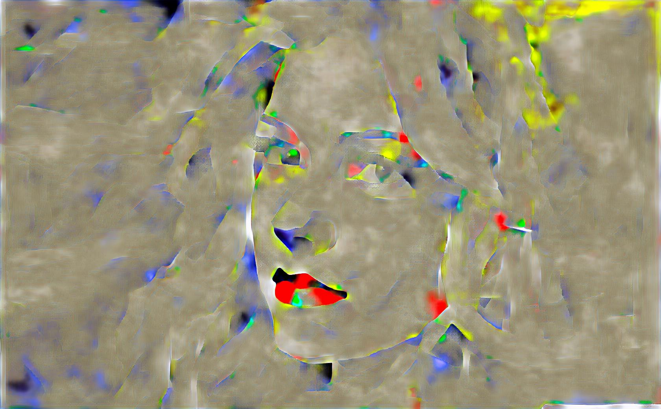
Experiments: style transfer
Mean
reflection padding
Zero
padding

Slide 17
Thanks for listening
Q&A

